Slide 1
Soft robot perception using embedded soft sensors and recurrent neural networks
Journal club presentation
Charles DeLorey
30/06/2021

Slide 2
Overview
Introduction
Fabrication and modeling
Results
Questions

Slide 3
Sensing and perception for soft robots
Rigid robots | Soft robots
Traditional robotics Highly accurate sensors and sensing systems Well-defined mathematical modelling of robot system | Newer form of robotics Traditionally implemented sensors unable to fully represent dynamic soft robot system High dimensionality results in greater complexity of modelling

Slide 4
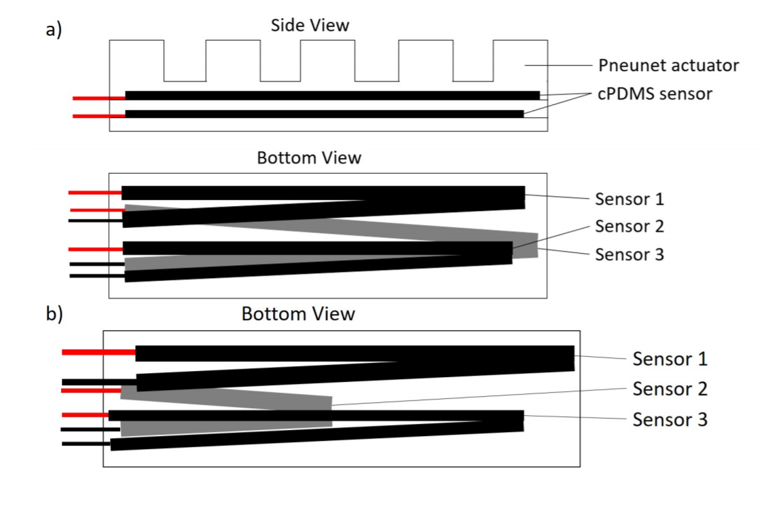
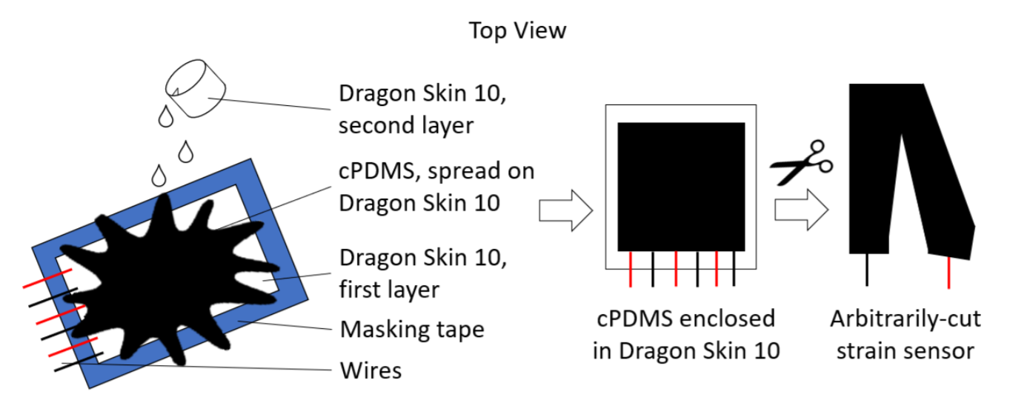
Methods - Fabrication of soft strain sensor

Slide 5
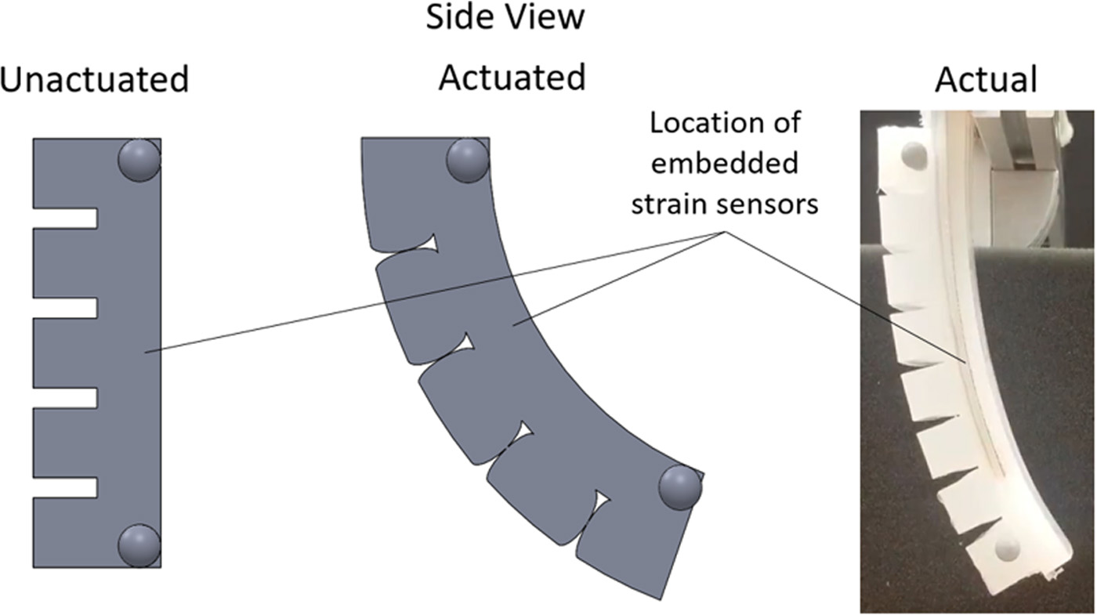
Methods - Fabrication of soft robot

Slide 6
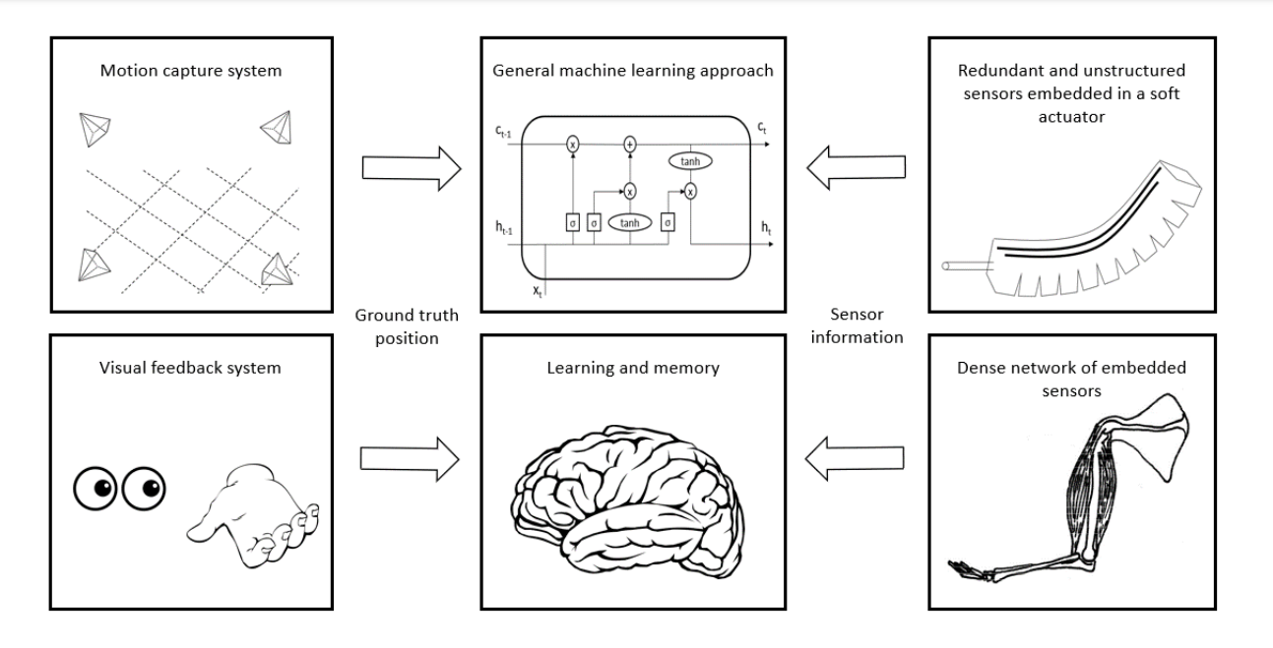
Machine learning - LSTM (RNN) network

Slide 7
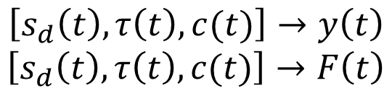
Machine learning - LSTM model process
Network input and output mapping
Estimated tip position
Features:
Can operate in parallel
Agnostic to sensor type
$$\left[s_{d}\left(t\right), τ\left(t\right), c(t)\right]→y\left(t\right)$$
$$\left[s_{d}\left(t\right), τ\left(t\right), c(t)\right]→F\left(t\right)$$
Estimated force values
Sensor impedances
Input pressure
LSTM state

Slide 8
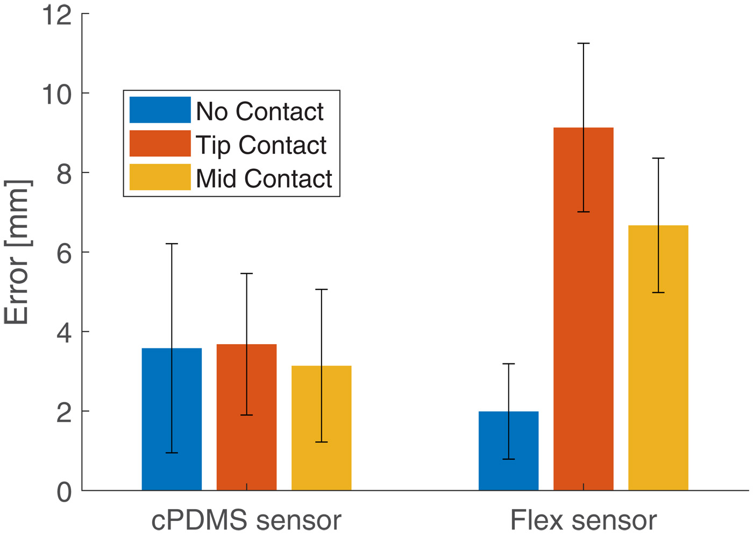
Results – Soft sensor v flex sensor
Real-time performance
Training performance of the network
Parameter | cPDMS | Commercial flex sensor
Samples | 29000 | 10000
Training Error | 2.32 ± 2.06mm | 1.08 ± 1.11mm
Test Error | 3.58 ± 2.83mm | 1.69 ± 1.51mm
Better performance from the flex sensor, except when in contact

Slide 9
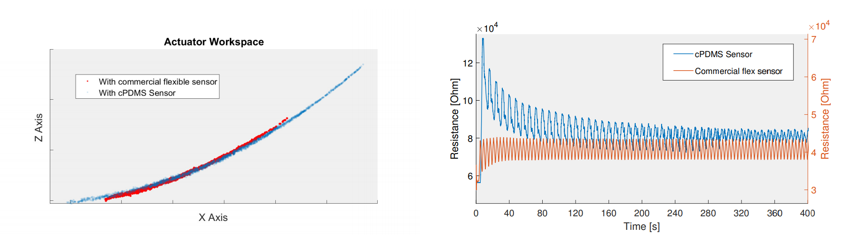
Results - Kinematic modeling
Workspace (a) and drift effect (b) in soft sensor and flex sensor
(a)
(b)
Significantly reduced workspace with flex sensor
Slight temporal difference (soft sensor lag)

Slide 10
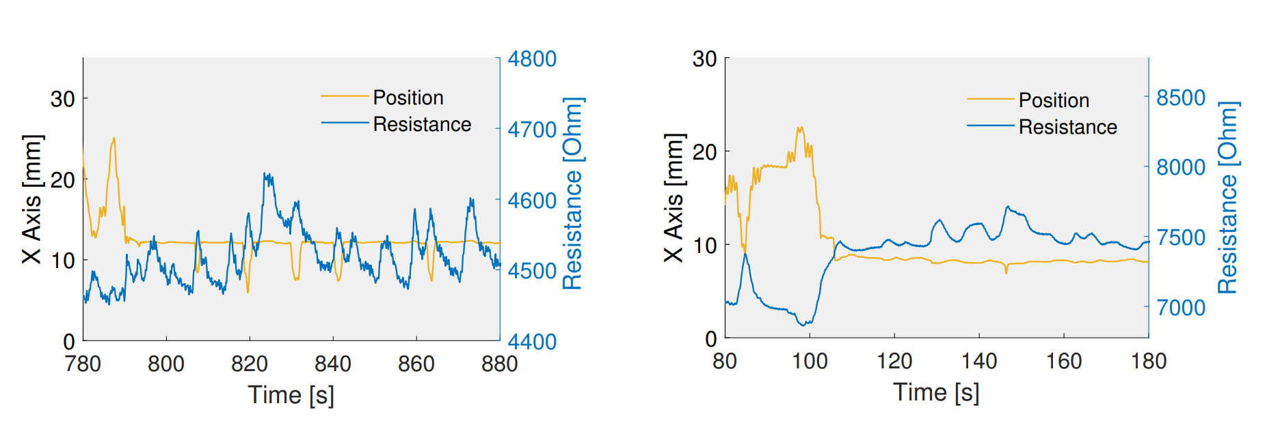
Results - Kinematic modeling
Sensor response to tip contact on soft sensor (a) and flex sensor (b)
No response to actuation input
Response to actuation input

Slide 11
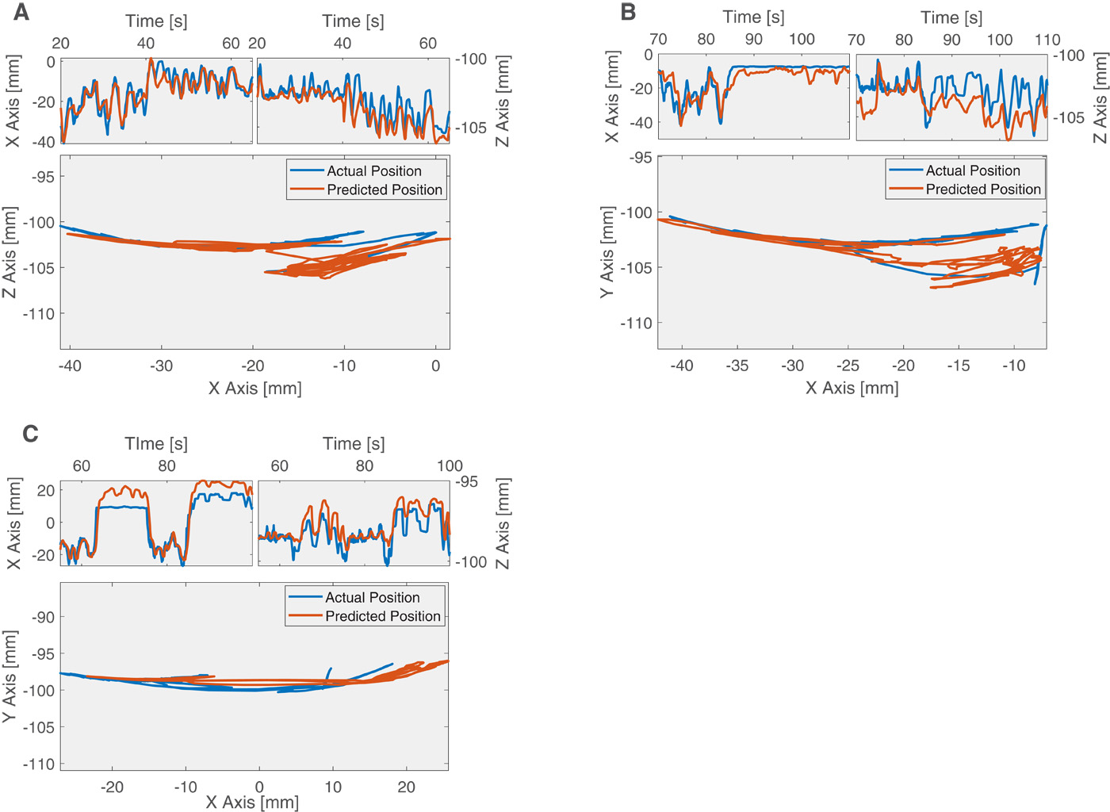
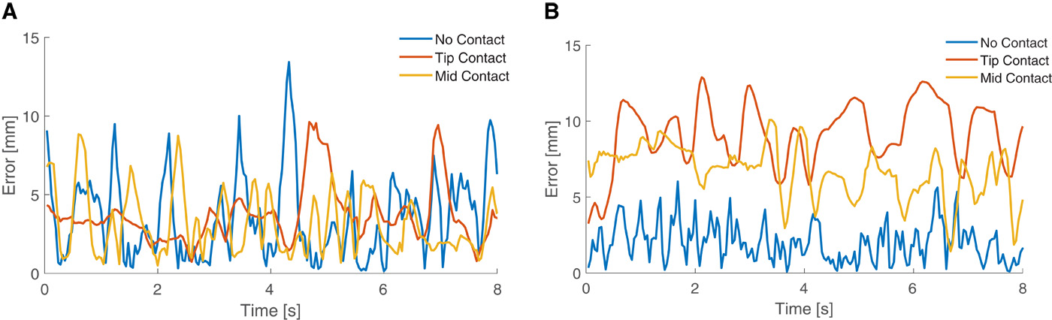
Results - Kinematic modeling
cPDMS sensor
cPDMS sensors, contact at finger centre
cPDMS sensors, contact at fingertip
Predicted motions of the fingertips
Flex sensor
Flex sensor, both contact points
Tracking error plots

Slide 12
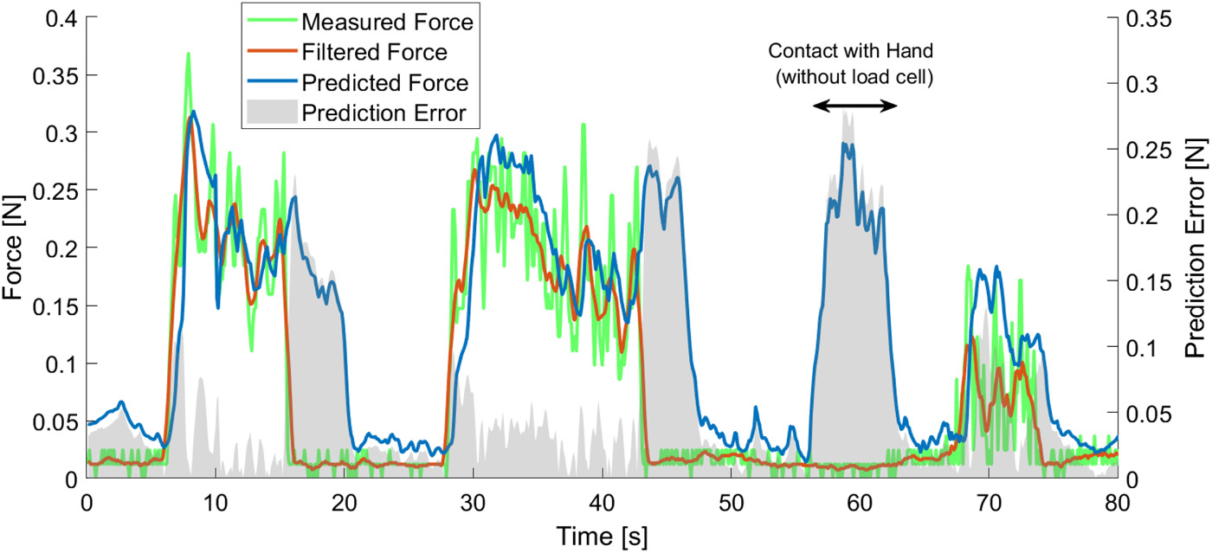
Results - Force modeling
Phase difference between filter and predicted force
Force prediction at fingertip

Slide 13
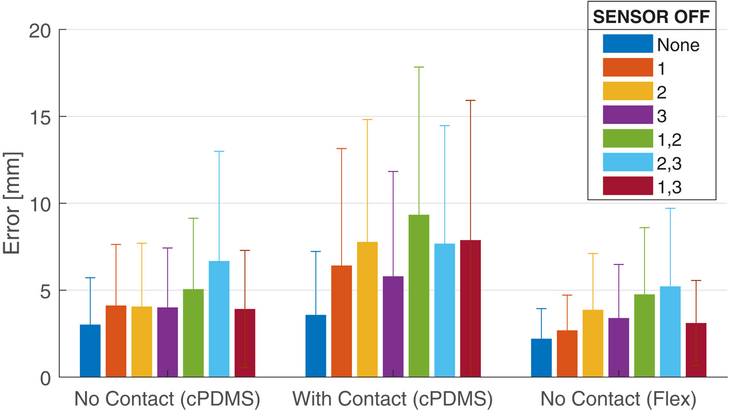
Results - Graceful degradation
More error with at least one missing sensor
Test accuracy with virtual sensor removal

Slide 14
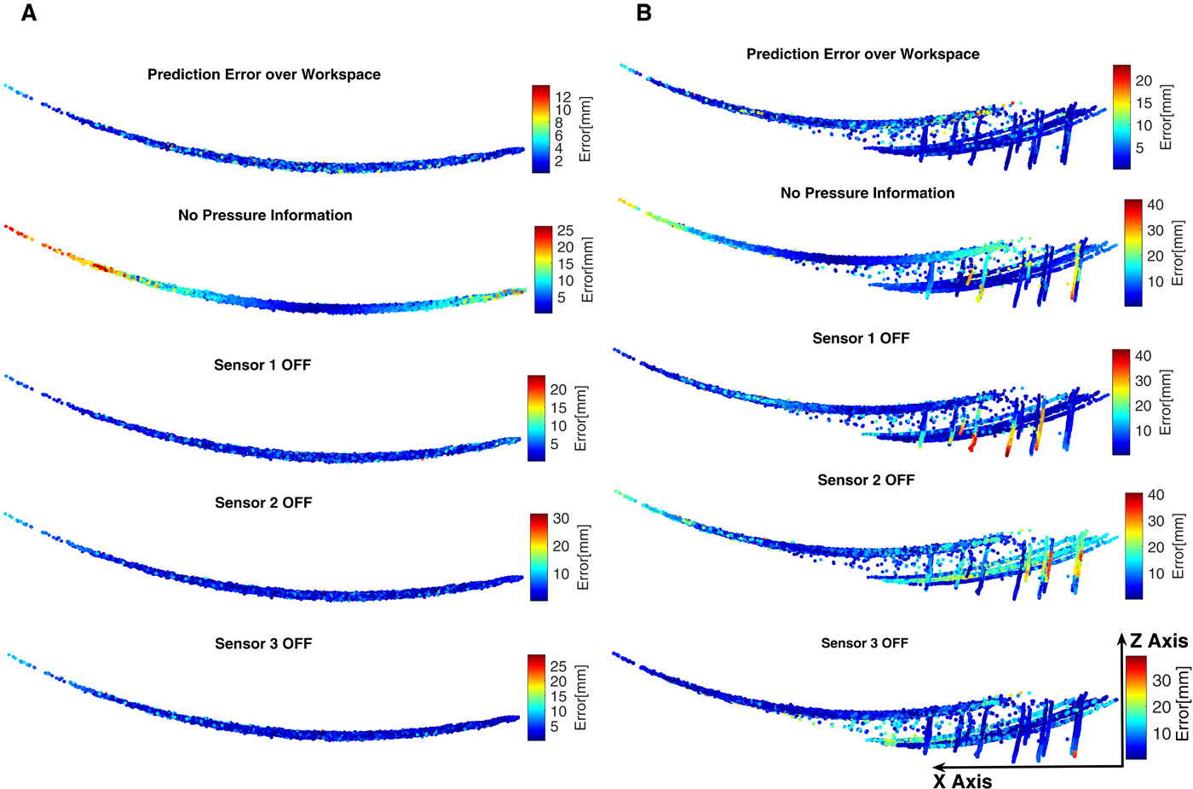
Results - Graceful degradation
Division of labor among the sensors
No pressure data significantly impacted performance
No contact
Contact

Slide 15
Conclusions
Bioinspired model-less approach
Accurate kinematic model achieved using soft sensors
Learning system effective in learning externally applied forces as well as degradation of sensors
Learning-based approaches perform well when based on minimal system knowledge
However, are unable to provide physical feedback from the system
Time lags in input require manual correction
Other network architectures should be investigated for better performance and handling of input data

Slide 16
Questions

Slide 17
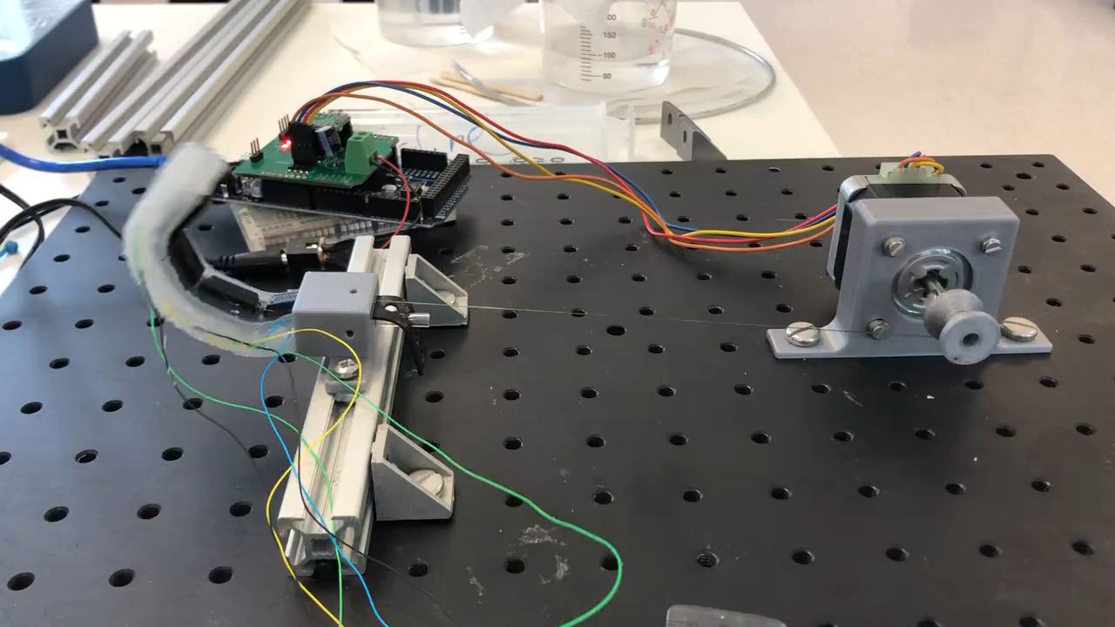
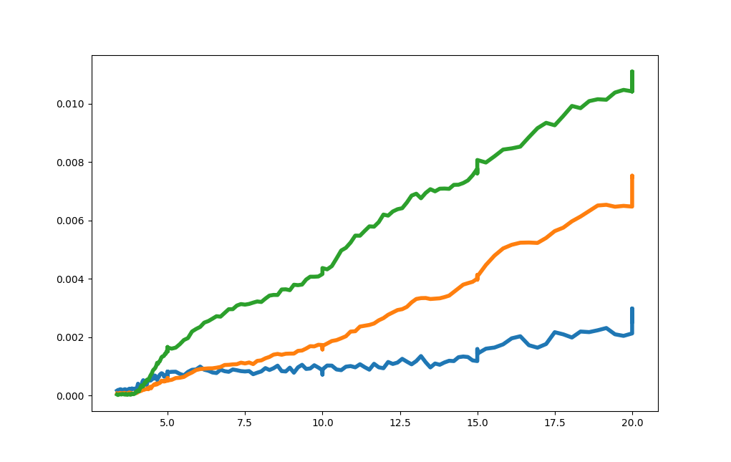
MRes project
Soft robot actuator with electrical impedance tomography (EIT) sensing method
Manufactured distance data with voltage change
Change in voltage (mV)
Cable pull distance (mm)
Video of actuation system with soft robot finger

Slide 18
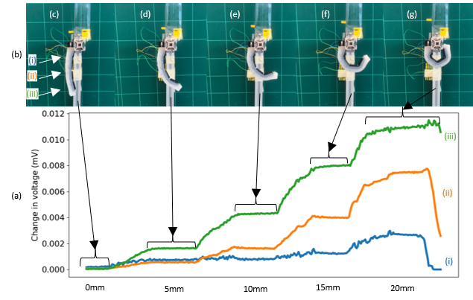
MRes project
Similarities:
Using soft sensing technique on a soft robot
1-DoF actuator
Differences:
Physical limitations of cPDMS necessitate high measurement frequency (300 KHz), unlike my 50 KHz
cPDMS sensors become less conductive the more they strain; not my EIT chamber
Figure - (a) EIT voltage changes at bend points during cable actuation, with (b) corresponding electrode pairs (i-iii). Cable-driven actuator pulled to (c) 0mm, (d) 5mm, (e) 10mm, (f) 15mm and (g) 20mm.

